Slide 1
Medical Chatbot
Team Rocket
Reed White
Manual Buffa

Slide 2
Overview
Introduction
Dataset
Dataset Augmentation
Neural Network (NN)
Retrieval Augmented Generation (RAG)
Comparing NN and RAG
Large Language Models (LLMs)
Demos

Slide 3
Introduction
This project aimed to develop a basic medical chatbot based on the intent-definition system defined by the Katana ML team.
We developed two main methods to identify intent:
Neural Network
Semantic Router (cornerstone of a RAG)
The ability of each to predict an intent was compared, and chatbots were built on both.

Slide 4
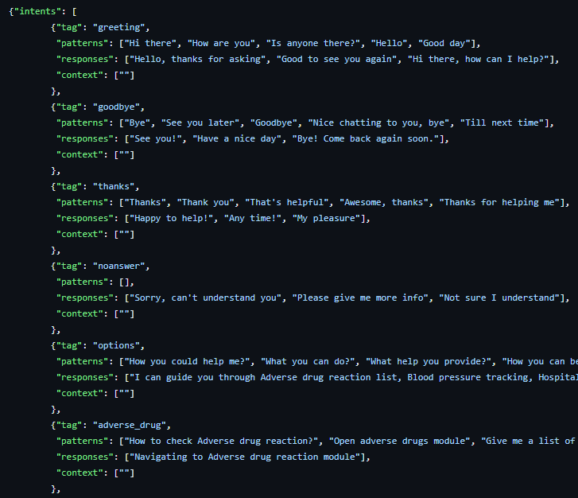
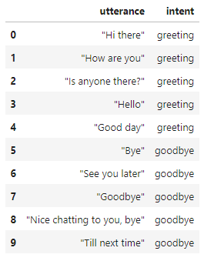
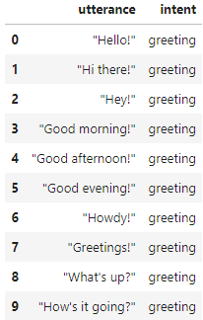
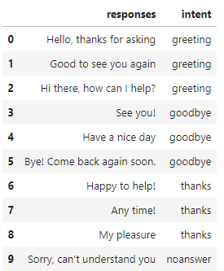
Dataset
The initial dataset was pulled from the Katana ML Github Repository.
Additional intents were manually created, and new patterns/utterances for all intents were created using an external LLM, ChatGPT.
Responses were separated from the given intents.

Slide 5
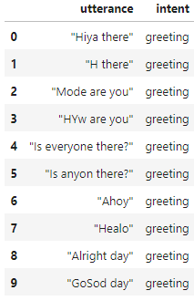
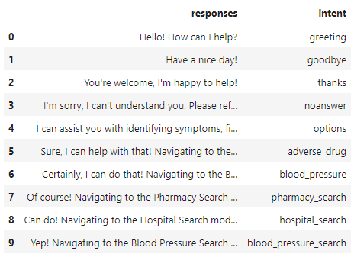
Dataset Augmentation
The initial datasets were combined and augmented using TextAttack, effectively tripling the sample set.
The initial responses were manually simplified and modified, to reflect the desired personality of the chatbot.
The augmented intents list was split into test and train datasets prior to any training.

Slide 6
Neural Network
A basic Keras Neural Network was trained on the training data, using the Katana ML team’s code as a base.
Each utterance was first broken down into words. The words were then stemmed and added to a bag of words. The stemmed words in the bag of words were all labeled with their intents.
The model was created with an input layer (dense), 3 hidden layers (dropout, dense, dropout), and an output layer (softmax) and trained on the bag of words.
The NN’s prediction accuracy, recall, and precision were then evaluated using the testing data. Of course, any predicted text had to be broken down into a bag of words before being predicted.

Slide 7
Retrieval Augmented Generation (RAG)
A RAG was configured using Aurelio AI Labs’ Semantic Router. A RAG is a relatively-new process that aims to “fine tune” an LLM without actually fine-tuning it.
This was significantly simpler to set up, as the Semantic Router did all of the work, so long as it was provided a set of routes and an LLM encoder (it includes HuggingFace by default).
Of course, the train dataset had to first be broken down into a list of routes, where each route contained all of the utterances tied to that intent.
The RAG’s prediction accuracy, recall, and precision were then evaluated using the test data. In this case, the test data didn’t need any preprocessing, the Semantic Router accepted it raw.

Slide 8
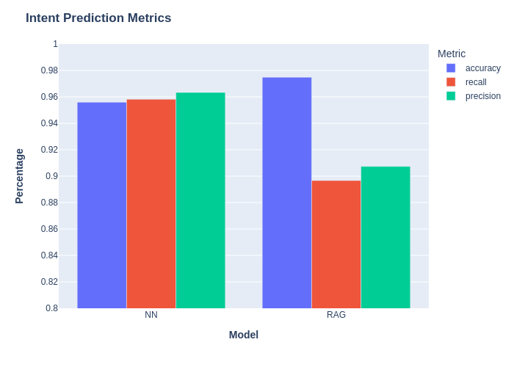
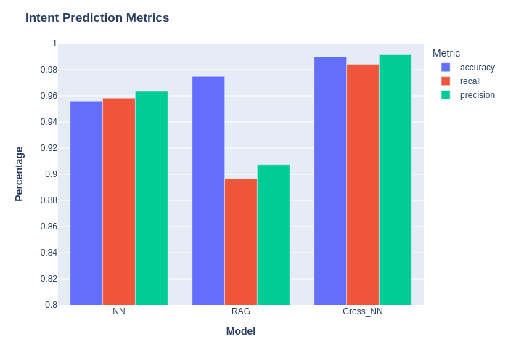
Comparing NN and RAG

Slide 9
Large Language Models (LLMs)
LLMs are a powerful, and increasingly popular, AI technology. Commercially introduced in 2022 via OpenAI’s ChatGPT, these are fundamentally built on the Transformer mechanism developed by Google’s DeepMind AI research team.
LLMs have some drawbacks. Training the model requires enormous amount of computing power, specifically GPU computing.
“Training a super-large language model like GPT-4, with 1.7 trillion parameters and using 13 trillion tokens (word snippets), is a substantial undertaking. OpenAI has revealed that it cost them $100 million and took 100 days, utilizing 25,000 NVIDIA A100 GPUs. Servers with these GPUs use about 6.5 kW each, resulting in an estimated 50 GWh of energy usage during training. If cloud costs were factored in at approximately $1 per A100 GPU hour, the cloud expenses alone would amount to around $60 million.” Research Institute of Sweden “Generative AI does not run on thin air!” Published: 2023-10-08

Slide 10
Language Models Move forward
Out with the Large, in with the Small
The massive resources required for developing, training, and deploying LLMs is prohibitive for individuals and smaller entities (research groups, small/medium businesses) to accomplish.
As with all new technology, the quest for ubiquitous usefulness is moving forward at full steam. Suspicions about data privacy, monopolization, and general FOMO are pushing this newly reborn industry towards locally customized and deployed models.
A distinct route being explored is the Small Language Model (SLM). These are Language models designed to run with modest IT resources that are easily attainable by individuals/groups.
A key goal of the project was to take a “small” Pre-Trained Model (PTM) that is not usable “out-of-the-box” and perform training operations on the model to make a working chatbot.

Slide 11
The Training Specifics
We chose Phi-1.5 – this is an auto-complete model. It is not very usable without additional training.
Datasets used: gamino/wiki_medical_terms, ruslanmv/ai-medical-chatbot, fedml/PubMedQA_instruction, openai/gsm8k, databricks/databricks-dolly-15k
I tested a variety of “trainers”, tools, and techniques on the Phi-1.5 model.
HuggingFace (HF) Transformers Trainer() class, the HF TRL SFTTrainer() class, and a couple of custom training routines.
Dataset preparation is also a key aspect that requires a cautious approach. Misformatting can negate a multi-hour training process.
Next slides will cover the challenges and successes of this process.

Slide 12
The Challenges
If it were easy, everyone would do it…
Main challenges:
The OS… an unending source of true frustration… Windows 11.
The Python version/environment - almost as headache inducing as the Windows system.
Getting the NVIDIA GPU to work with PyTorch. Days of frustration with this… just… wow…
Navigating the AI information ecosystem. To be expected but a serious hurdle regardless.
Testing routines, a logical consequence of the nature of the AI dev collective.
What, Where, When, Why, and How?!?! The method guides, don’t use the same model or datasets; the model guides don’t use the same methods or datasets; the dataset guides don’t use the same model or methods. Huh?!?!
The time required… This process is time consuming! Trial and error experimentation is key.

Slide 13
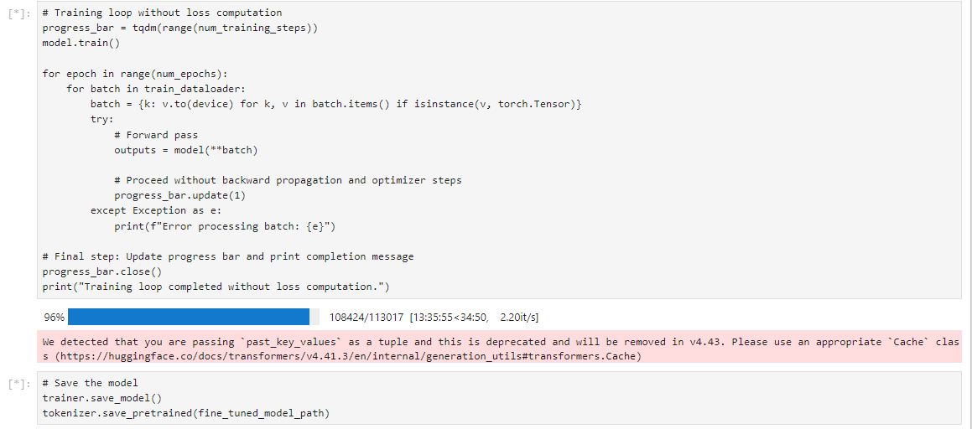
The Successes!
Learning lessons from failure…
I eventually got the NVIDIA GPU and CUDA software to work with PyTorch.
I managed to complete limited training using Supervised and Unsupervised routines with different types of dataset.
I also implemented a Quantization process with Low Rank Adaptation (LoRA), though the results were mixed.

Slide 14
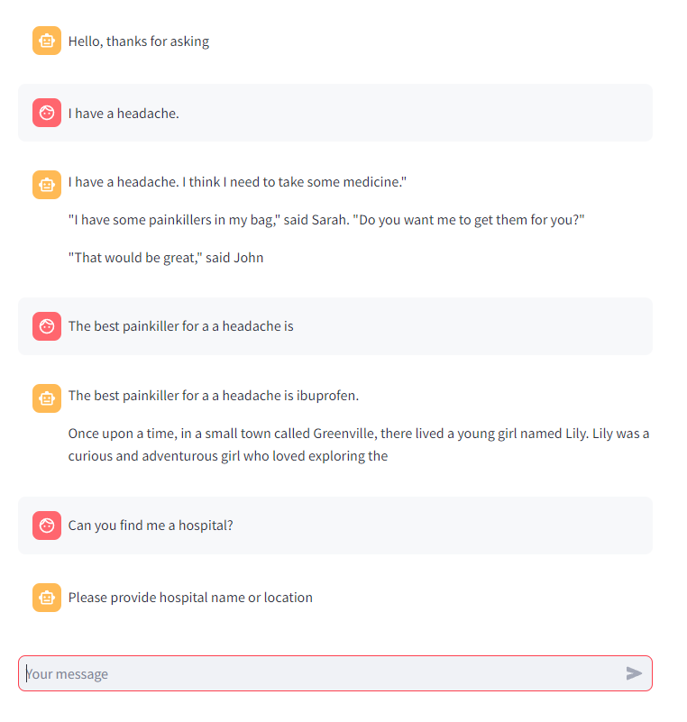
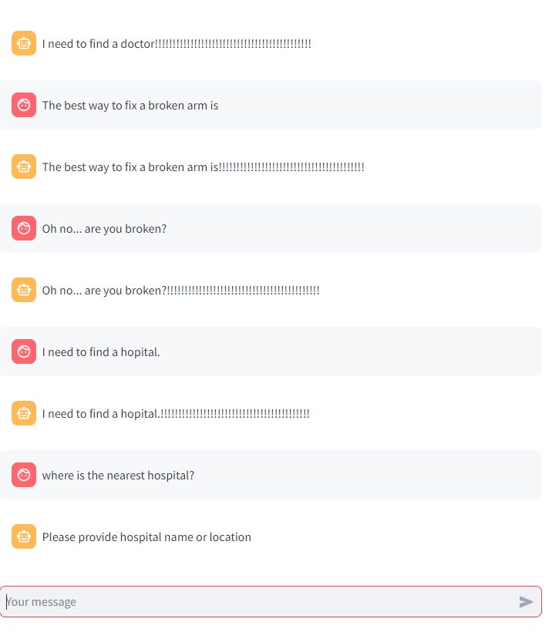
Well.. that is odd…

Slide 15
Lessons for next time
I won’t do that again…
The system/environment: Linux OS (Debian?), CUDA 11.8 or 12.1, Python 3.11
The tools: NVIDIA APEX (for my setup) or Microsoft DeepSpeed (build out from here)
The model: Phi-1.5 is “old” and silly, could use new Gemma or Phi, or build out a neural network from scratch
The methods: Dependent on tools, goals, and deadlines. Different goals require different datasets and training methods
Despite “unsuccessful” experiments this time, the field is wide open for R&D in the field of custom Small Language Models deployable in Edge systems with local processing/training.

Slide 16
Demos
Neural Network
RAG with PHI 3-Instruct

Slide 17

Q/A
Github: https://github.com/mist861/5530-Principles-of-Data-Science/tree/main/Project

